Slide 1

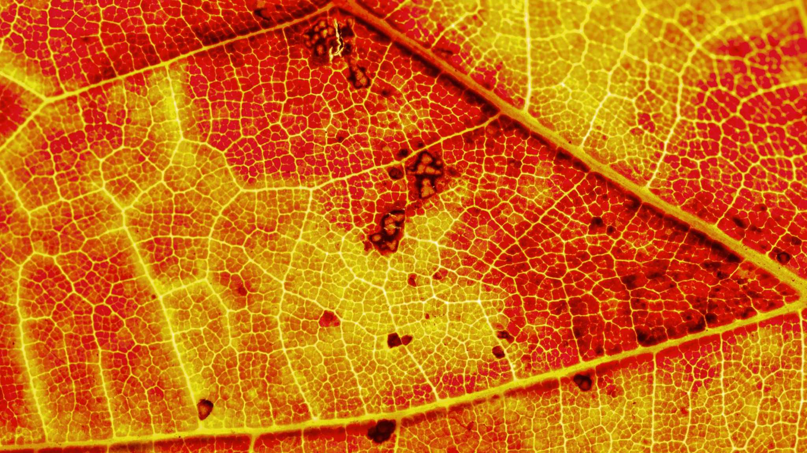
GRAPE LEAF DISEASE IDENTIFICATION USING MACHINE LEARNING TECHNIQUES

Slide 2



Team members:
1. Vamsi Krishna Mekala, 700742751
2. Pavani Katkuri, 700732649
3. Mahathi Reddy Panyala, 700743307
4. Ranga Jayanth Kumar, 700740660

Slide 3

Role / Responsibilities and Contribution in project
○ Problem description and dataset formation: Images for the dataset are downloaded and then they are preprocessed using the python CV2 library with various image processing techniques. Vamsi Krishna Mekala, 700742751 did this task.
○ Feature Extraction for 2 classes of image(Blackrot and Escala): Applied the grab cut algorithm background elimination to get the features of the leaf sample and the affected region. Pavani Katkuri, 700732649 did this task.
○ Feature Extraction for 2 classes of image(Leaf blight and Healthy leaf): Applied the grab cut algorithm background elimination to get the features of the leaf sample and the affected region. did this task.Mahathi Reddy Panyala, 700743307 did this task.
○ Creating the model and parameters according to the training data and also fitting the data to the model: Here we created the Bagging algorithm and fitted the preprocessed data to the model. Ranga Jayanth Kumar, 700740660 did this task.

Slide 4

Motivation
Grape is a largely cultivated crop over the world and early detection of such grape leaf diseases yields higher crop production ith preventive steps prior

Slide 5
Objectives
To build a machine learning application that accurately classifies the given leaf image into it respective diseased version using bagging algorithms

Slide 6
RELATED WORK
The system proposed a segmentation method which has used mean based strategy for computing threshold and textual features were extracted and classification was done by Support vector Machine(SVM).
The survey proposed by Vijay et al. in , discuss about different disease classification techniques used for plant leaf disease and used genetic algorithm for image segmentation.
An integrated approach of particle swarm optimization and SVM for plant leaf disease detection and classification was proposed in.
Disease detection system for pomegranate leaves was proposed in which used color-based segmentation and features like color, morphology and texture for classifying the leaves.

Slide 7
Problem Statement
Grape, which is a widely grown crop globally and it may be affected by different types of diseases on leaf, stem and fruit. Leaf diseases which are the early symptoms caused due to fungi, bacteria and virus. So, there is a need to have an automatic system that can be used to detect the type of diseases and to take appropriate actions prior. We have proposed an automatic system for detecting the diseases in the grape vines using image processing and machine learning techniques. The system segments the leaf from the background image using grab cut segmentation method. From the segmented leaf part the diseased region is further segmented based on two different methods such as global thresholding and using semi supervised technique. Here we are considering mainly 4 classes for the classification task. They are Leaf blight, Escala, Black rot, and Healthy leaf. We are going to consider an image dataset which has 4 classes of images in .jpg format and also a .csv file with leaf measurements as data.

Slide 8
Proposed Solution
We have proposed an automated disease detection and classification system for grape leaves using traditional image processing and machine learning techniques. The proposed system first segments the ROI from the background using grab cut algorithm and classify the segmented leaves as healthy, balck-rot, esca and leaf blight. Figure. 1 depicts different types of disease in grape leaves. These diseases are caused due to fungi infection on the leaves. Each disease have different characteristics where black rot appears to be circular in shape and has dark margins, esca appears as dark red stripes and leaf blight appears to be solid reddish-purple spots. The proposed system consists of five different process such as image preprocessing, image segmentation, feature extraction, disease detection and identification.

Slide 9

Results/Simulations
We have evaluated the proposed system using 5675 grape leaves which have been downloaded from the plant village website and also from web. We have used 80%of the images for training and others for testing. The global thresholding method used for segmenting leaf disease part was found to be more suitable for training the model as it segments the precise diseased part of the leaves which leads to improved classification results. Training accuracy obtained using different machine learning techniques are summarized in Table. I. From the results it is evident that good training accuracy is achieved when the features are extracted from the diseased part of the images using global thresholding and trained using SVM classifier with tuned parameters since SVM performs good when the data is highly nonlinear. The overall accuracy obtained is 93.035% for 1135 test images.

Slide 10
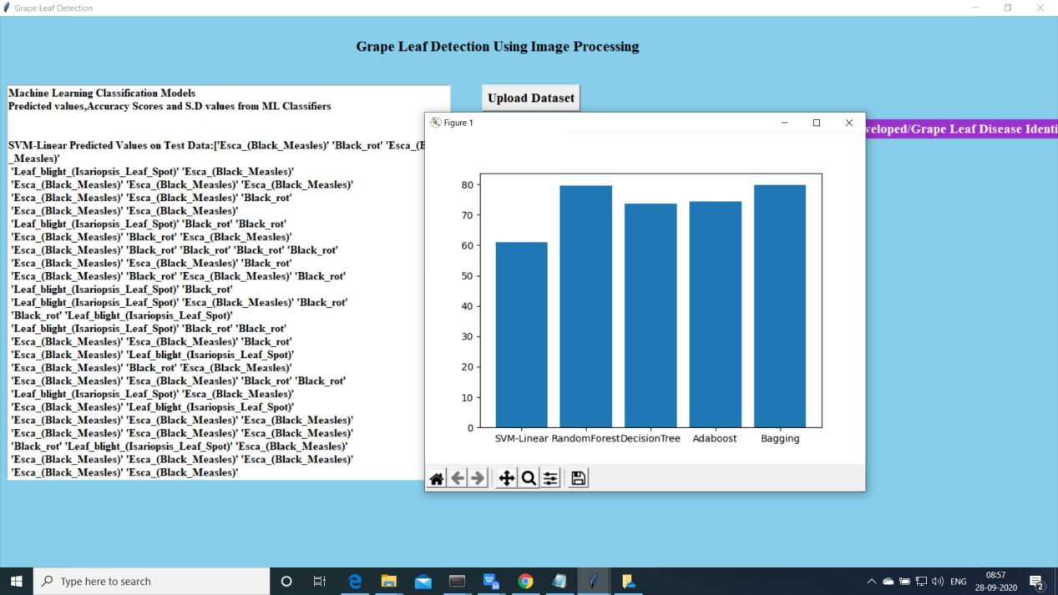

Slide 11
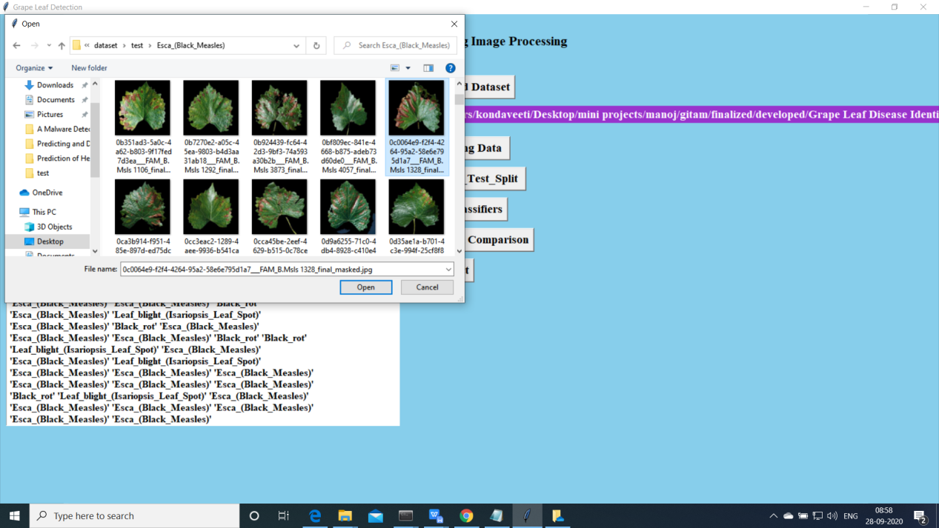

Slide 12
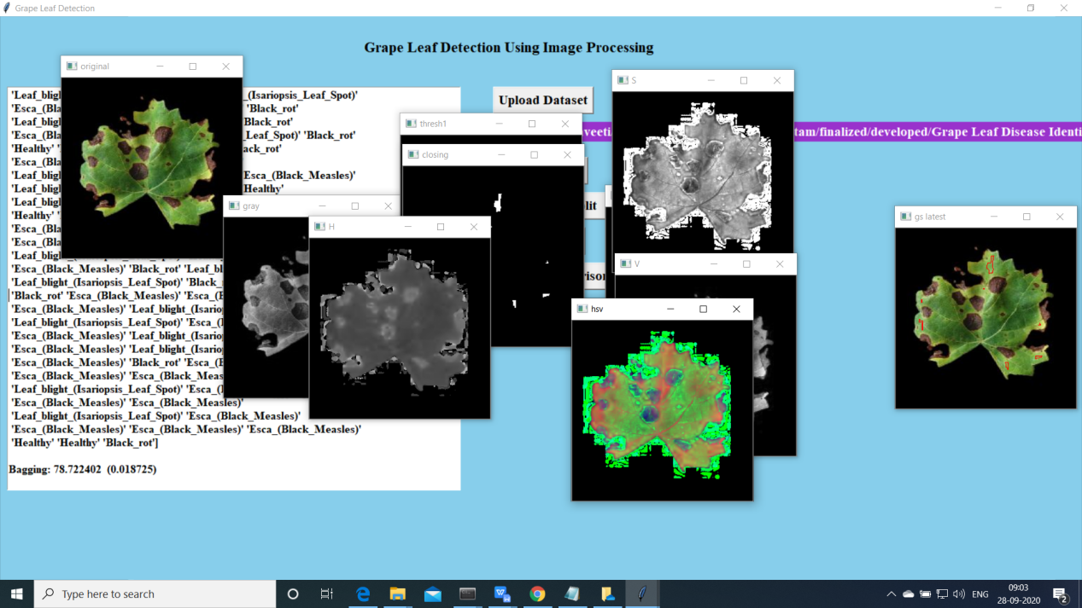

Slide 13
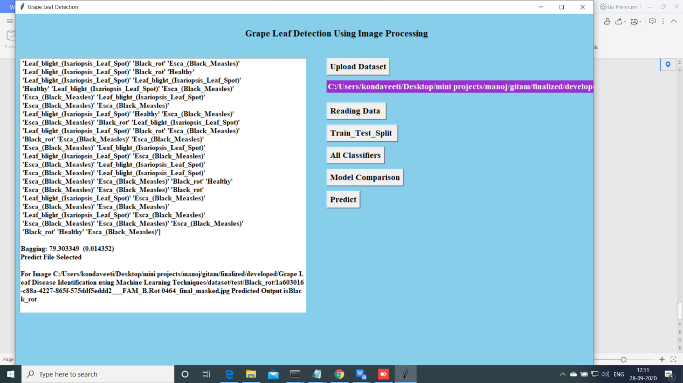

Slide 14
References
[1] Agrawal, G.H., Galande, S.G., Londhe, S.R.: Leaf disease detection and climatic parameter monitoring of plants using iot 4, 9927 – 9932 (2015)
[2] Al-hiary, H., Bani-ahmad, S., Reyalat, M., Braik, M., Alrahamneh, Z.: Fast and accurate detection and classification of plant diseases. International Journal of Computer Applications 17(1) (2011)
[3] G.Prem Rishi Kranth, HemaLalitha, LaharikaBasava, AnjaliMathurh: Plant disease prediction using machine learning algorithms. International Journal of Computer Applications 18(2) (2018)
[4] H.Sabrol, K.Satish: Tomato plant disease classification in digital images using classification tree. In: 2016 International Conference on Communication and Signal Processing (ICCSP), pp. 1242–1246 (2016)
[5] Khot.S.T, Supriya, P., Gitanjali, M., Vidya, L.: Pomegranate disease detection using image processing techniques 5(1), 2248 – 2251 (2016)
[6] Mokhtar, U., Ali, M.A.S., Hassenian, A.E., Hefny, H.: Tomato leaves diseases detection approach based on support vector machines. In: 2015 11th International Computer Engineering Conference (ICENCO), pp. 246–250 (2015)
[7] Mwebaze, E., Owomugisha, G.: Machine learning for plant disease incidence and severity measurements from leaf images. In: 2016 15th IEEE International Conference on Machine Learning and Applications (ICMLA), pp. 158–163 (2016)
[8] Nandhini, A., Hemalatha, Radha, Indumathi: Web enabled plant disease detection system for agricultural applications using wmsn. Wireless Personal Communications 102(2), 725–740 (2018)
[9] Nivedita.R.Kakade, Dnyaneswar.D.Ahire: Real time grape leaf disease detection 1, 598 – 610 (2015)
[10] P, K., S, S., S, S.: Detection and classification of leaf diseases using integrated approach of support vector machine and particle swarm optimization. 4(1), 79 – 83 (2017)

Slide 15
THANK YOU

